Slide 1

Comparative Model Evaluation and Feature analysis for Network Intrusion Detection System
MS in Data science Thesis defense
Presented By: Alisha Tak
Thesis Advisor: Gokhan Kul
Committee: Lance Fiondella, Firas Khatib, Ashokkumar Patel
Dated: 06/20/2025

Slide 2
Outline
Motivation and Scope
Dataset Overview
Data Exploration and Preprocessing
Feature Engineering
Model Evaluation
Conclusion

Slide 3
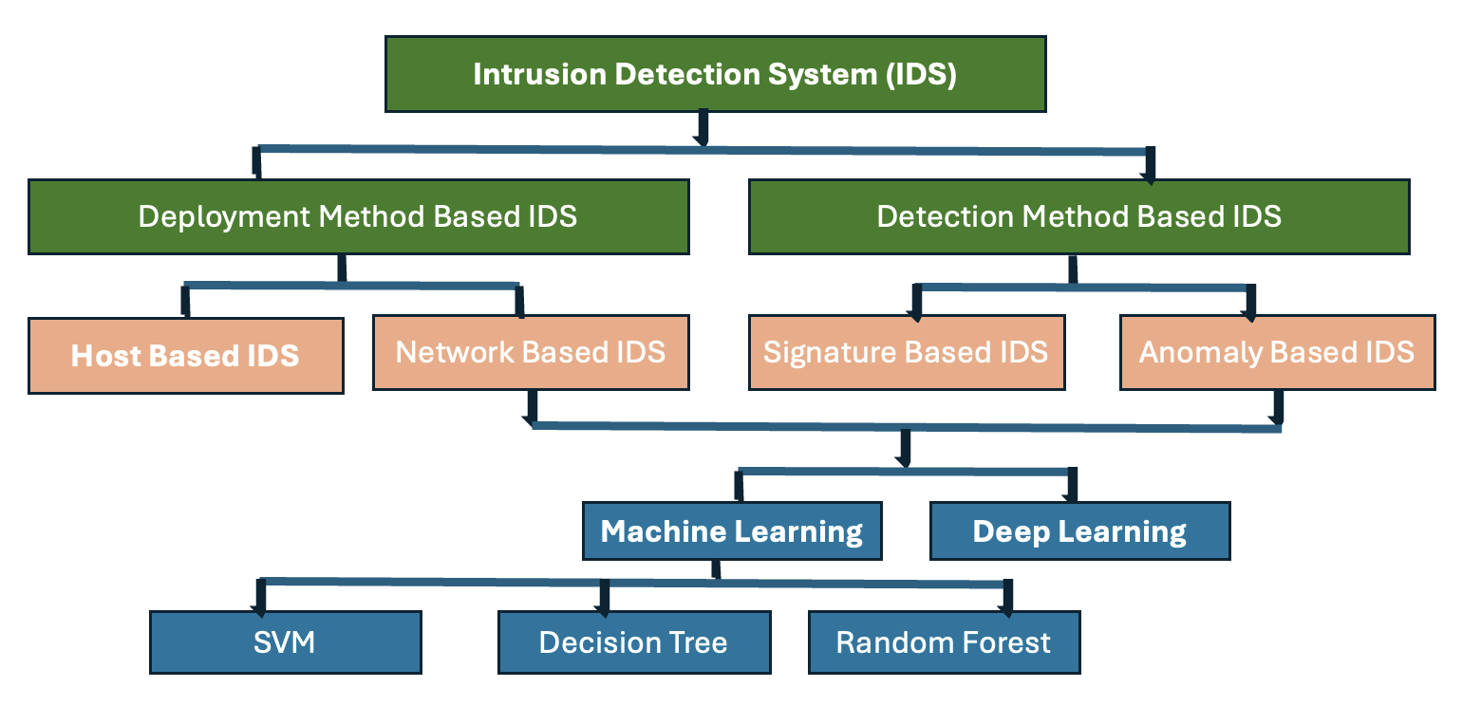
Motivation and scope
Increase in cyber-attacks and varieties poses a challenge in detecting intrusion, putting data confidentiality, integrity and availability at risk.
A traditional rule-based IDS, rely on predefined attacks, making them ineffective against new or evolving threats, highlighting the need for machine learning based systems.

Slide 4
OBJECTIVES
This thesis explore various feature sets extracted from network traffic and evaluates machine learning models to detect network intrusions.

Slide 5
Dataset overview
In the study, Army Cyber Institute PCAP traces (ACI IOT 2023) dataset has been used. This dataset is tailored for machine learning (ML) applications in the realm of IoT network security.
The dataset comes in two files:
ACI-Iot-2023.csv – Labeled dataset containing net flow features.
ACI-Iot-2023-Payload.csv – Labeled dataset using Payload-Byte, an open-source tool for extracting and labelling network packets.

Slide 6
ACI-Iot dATASET
Label | Value Counts
Port Scan | 441282
Benign | 329295
ICMP Flood | 225234
Ping Sweep | 71928
DNS Flood | 46935
Vulnerability Scan | 39537
OS Scan | 37524
Slowloris | 18643
SYN Flood | 13857
Dictionary Attack | 6380
UDP Flood | 791
ARP Spoofing | 5
The dataset is labeled, with 12 unique class labels representing various types of network activities or attacks.
The diversity and volume of the data provide a robust foundation for training models that can generalize well across different types of network threats.
Table: Class distribution of target variables

Slide 7
ACI-Iot pAYLOAD dATASET
Label | Value Counts
Benign | 441282
DNS Flood | 329295
Dictionary Attack | 225234
Slowloris | 71928
SYN Flood | 46935
Port Scan | 39537
Vulnerability Scan | 37524
OS Scan | 18643
UDP Flood | 13857
ICMP Flood | 6380
The dataset is labeled, with 10 unique traffic class labels.
This dataset offers payload analysis of lighter and faster alternatives for training models where features are essential and critical.
Table: Class distribution of target variables

Slide 8
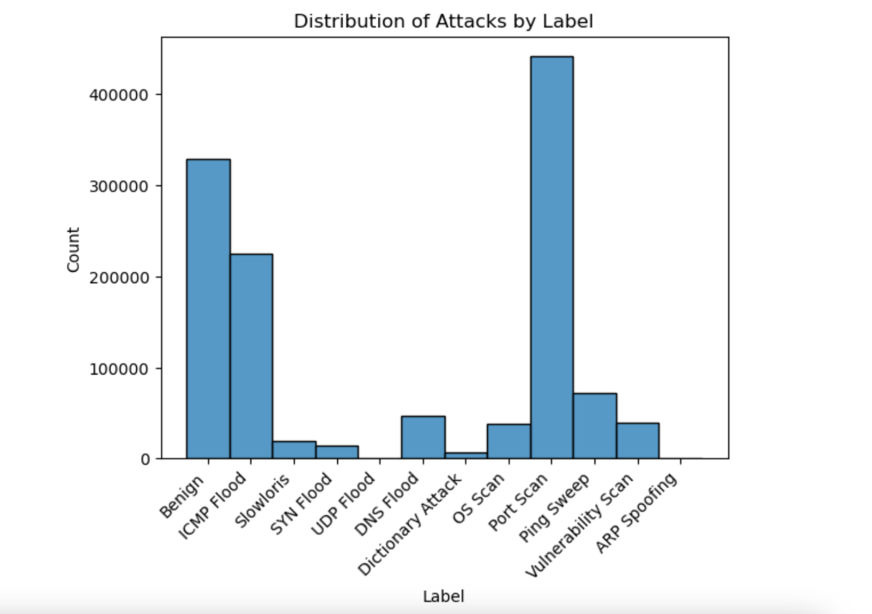
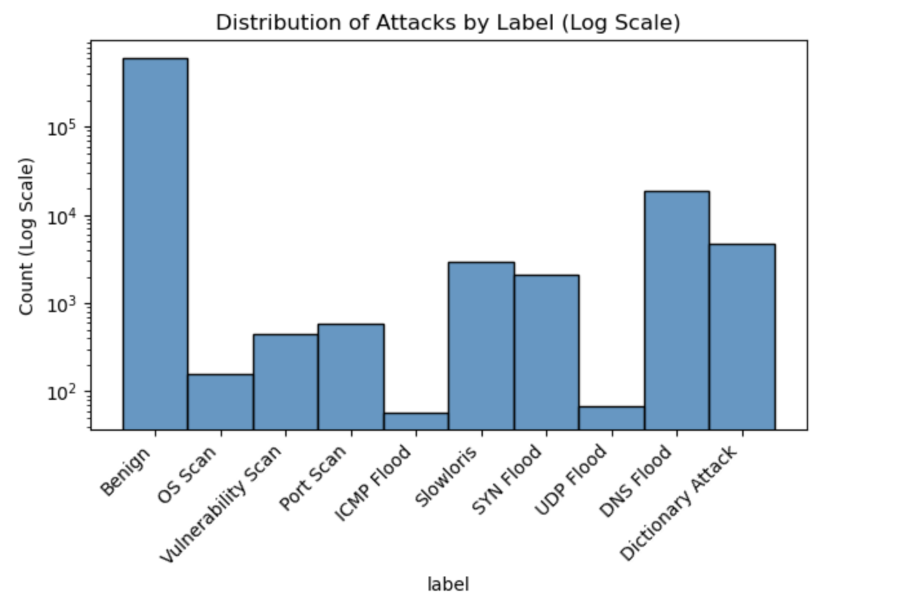
Data EXPLORATION
Exploratory Data Analysis (EDA) is a step in understanding the data, its structure, finding patterns, and characteristics of the dataset. EDA is conducted to find the distribution of features, class imbalance, missing values, and correlation among variables.
Distribution of label in ACI-IoT Dataset
Distribution of label in ACI-IoT Payload Dataset. Log scale for better visual

Slide 9
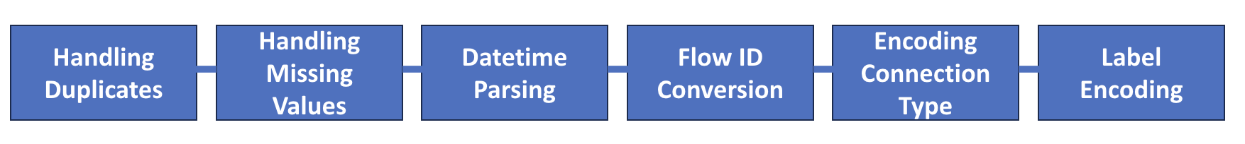
Data Preprocessing
It comprises cleaning, transforming, and organizing raw data into format that is suitable for analysis and input into machine learning models.
The steps applied to ACI-IoT Dataset:

Slide 10
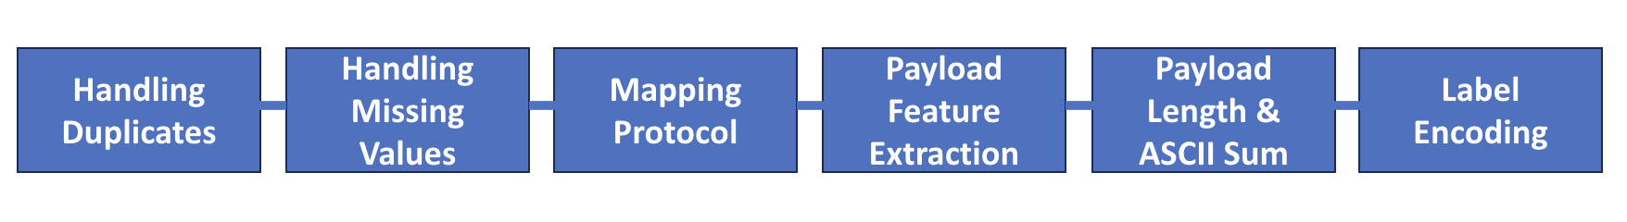
Data Preprocessing
The ACI-IoT Payload dataset underwent pre-processing procedures, as quality and cleanliness of data is essential for accurate model training and evaluation.
The steps applied to ACI-IoT Payload Dataset:

Slide 11
MANAGING CLASS IMBALANCE
The class distribution of labels was analyzed, and it demonstrated an imbalance among different classes.
A balanced dataset, enhances generalization and fairness in prediction as model can learn different features of all classes effectively.
Down Sampling - Each majority class label was down sampled to 10,000 samples by randomly selecting instances without replacement.

Slide 12
UP SAMPLING
Each majority class label was sampled up to 10,000, to ensure equal class distribution using Synthetic Minority Over-sampling Technique (SMOTE).
SMOTE – It is a method that generates synthetic samples for minority classes by interpolating new data points between existing instances or data points samples of the minority class. It provides more representative data and therefore balances the class distribution without simply duplicating samples. Hence, creating a balanced dataset without compromising the variance within the minority class, thereby preserving its intrinsic characteristics.

Slide 13
UP SAMPLING - SMOTE
SMOTE Procedure - For applying smote, the dataset was first preprocessed, first the features X were separated from the target variable Y by dropping the ‘Label’ column, and the target vector Y consisted solely of the class labels.
Features X was then cleaned to make that compatible with the smote algorithm.

Slide 14
FEATURE Engineering
Feature engineering improves model accuracy and reduces training time by focusing on the most relevant features, minimizing computational head.
Feature selection was applied to identify the most relevant attributes for model training. The techniques were used for both the ACI-IoT and its payload dataset.

Slide 15
FEATURE Engineering – Method 1
Variance Thresholding – A method that identifies features with low variance and removes them from the dataset.
VarianceThreshold transformer, with a threshold of 0 was implemented for identifying the constant features.
By eliminating these low-variance features, we can reduce noise in the data and improve model performance.

Slide 16
FEATURE Engineering – Method 2
Correlation Matrix Coefficient – A method that finds the variable that highly correlate with the target variable.
A function was created to identify features that have correlation coefficient above 0.8 and dropping the features for dimensional reduction.

Slide 17
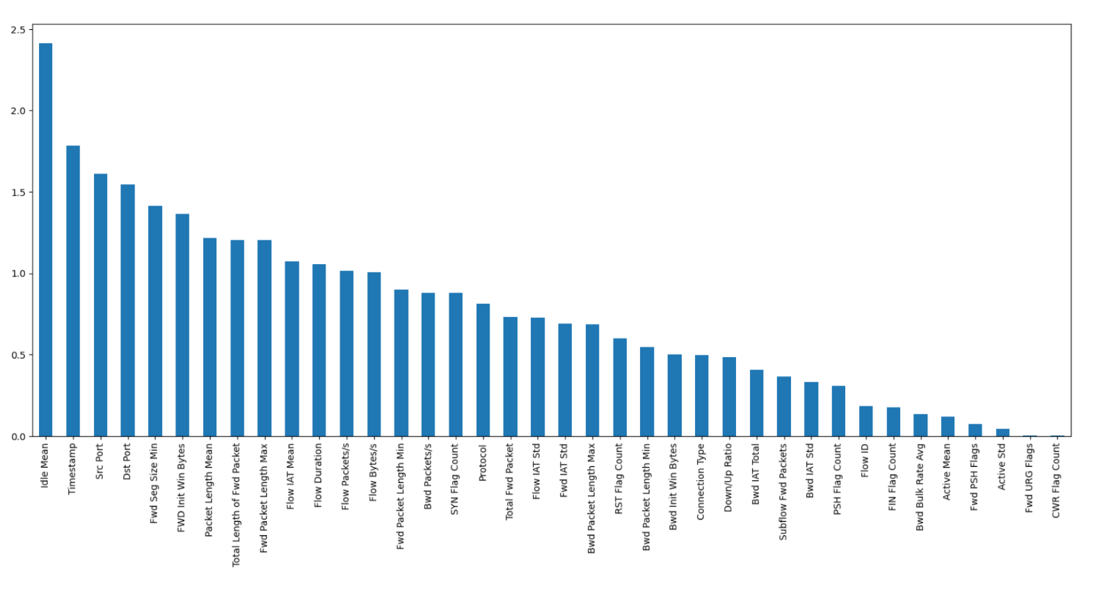
FEATURE Engineering - Method 3
Information Gain – A method that measures dependency between the variables, and measures how much presence or absence of a feature contributes to making the correct prediction of a target.
The Mutual_info_classif function was used to calculate mutual information score between each feature and the target variable.
Fig: Visualization of feature relevance

Slide 18
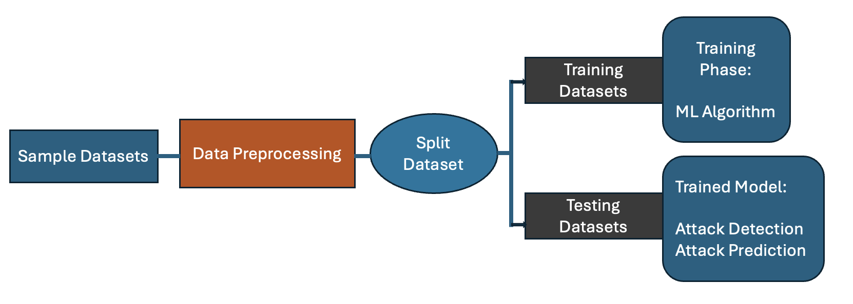
Machine Learning model
A machine learning model is a set of programs that can be used to find the patterns and make decisions from an unseen dataset.
Fig shows the main processes of detection system based on Machine Learning techniques.
In the study, three machine learning models were used for model evaluation.
Fig: In the study, training set is 70%, validation set is 15% and test set is 15% of the data

Slide 19
Support vector machine
SVM is a supervised machine learning algorithm; it classifies data by finding a best or optimal line or hyperplane that maximizes the distance between each class in an n-dimensional space.
The model was trained on original dataset that is, the data without any feature reduction technique. Also, trained on the processed data using Variance Threshold, Correlation based, and Mutual Information based feature selection techniques.
In the study, a function was created to train the model and compute performance metrics including accuracy, precision, recall, F1-score, and training time.
Confusion Matrix plotted for each dataset.

Slide 20
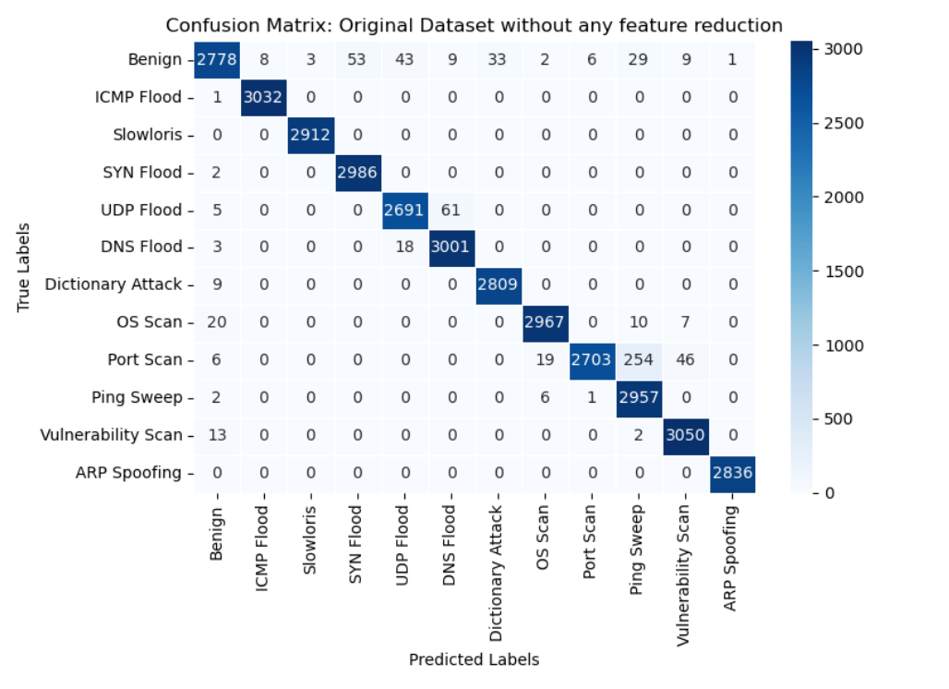
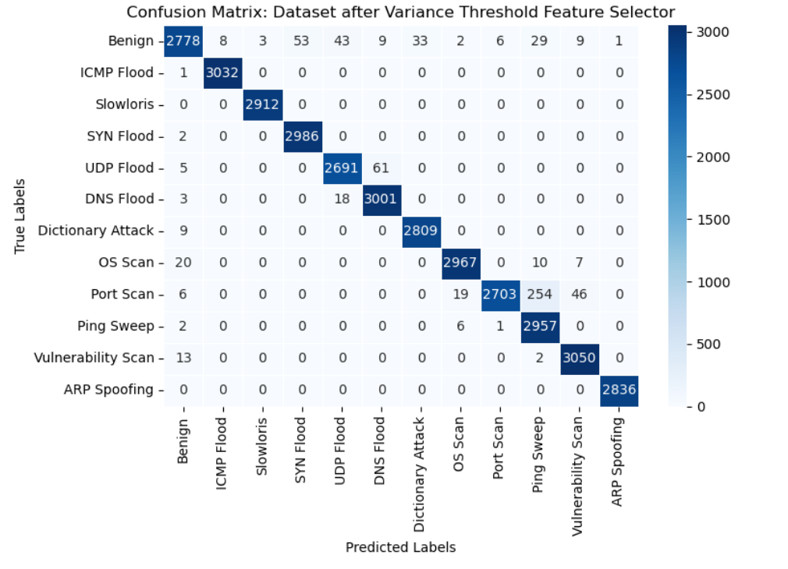
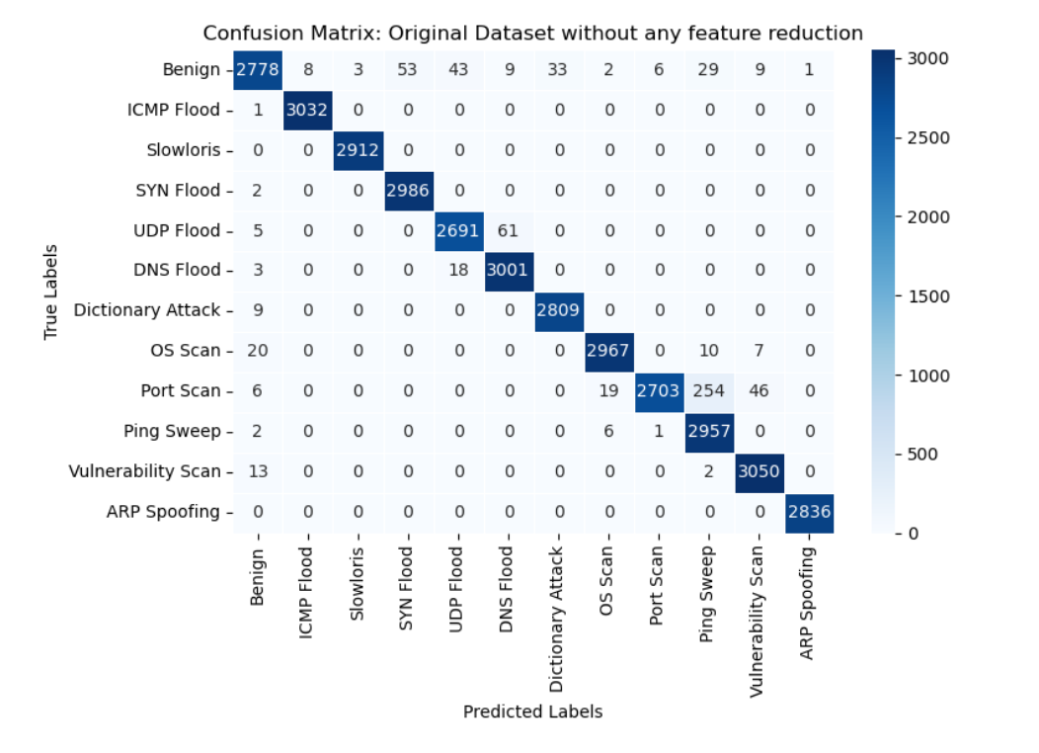

SVM - ACI-Iot Dataset
Fig 1: Confusion matrix heatmap for SVM on original ACI-IoT dataset (data withouth feature reduction). Performance metrics include Accuracy = 0.9808, Precision = 0.9815, Recall = 0.9810, and F1 Score = 0.9808, and Training time = 21.100 seconds.
Fig 2: Confusion matrix heatmap for SVM on ACI-IoT dataset (data after variance threshold feature selector method) Performance metrics include Accuracy = 0.9808, Precision = 0.9815, Recall = 0.9810, and F1 Score = 0.9808, and Training time = 18.790 seconds.
Fig 3: Confusion matrix heatmap for SVM on ACI-IoT dataset (data after correlated feature selector method) Performance metrics include Accuracy = 0.9710, Precision = 0.9717, Recall = 0.9712, and F1 Score = 0.9707, and Training time = 12.8100 seconds.
Fig 4: Confusion matrix heatmap for SVM on ACI-IoT dataset (data after mutual info feature selector method) Performance metrics include Accuracy = 0.9710, Precision = 0.9717, Recall = 0.9712, and F1 Score = 0.9707, and Training time = 12.1300 seconds.

Slide 21
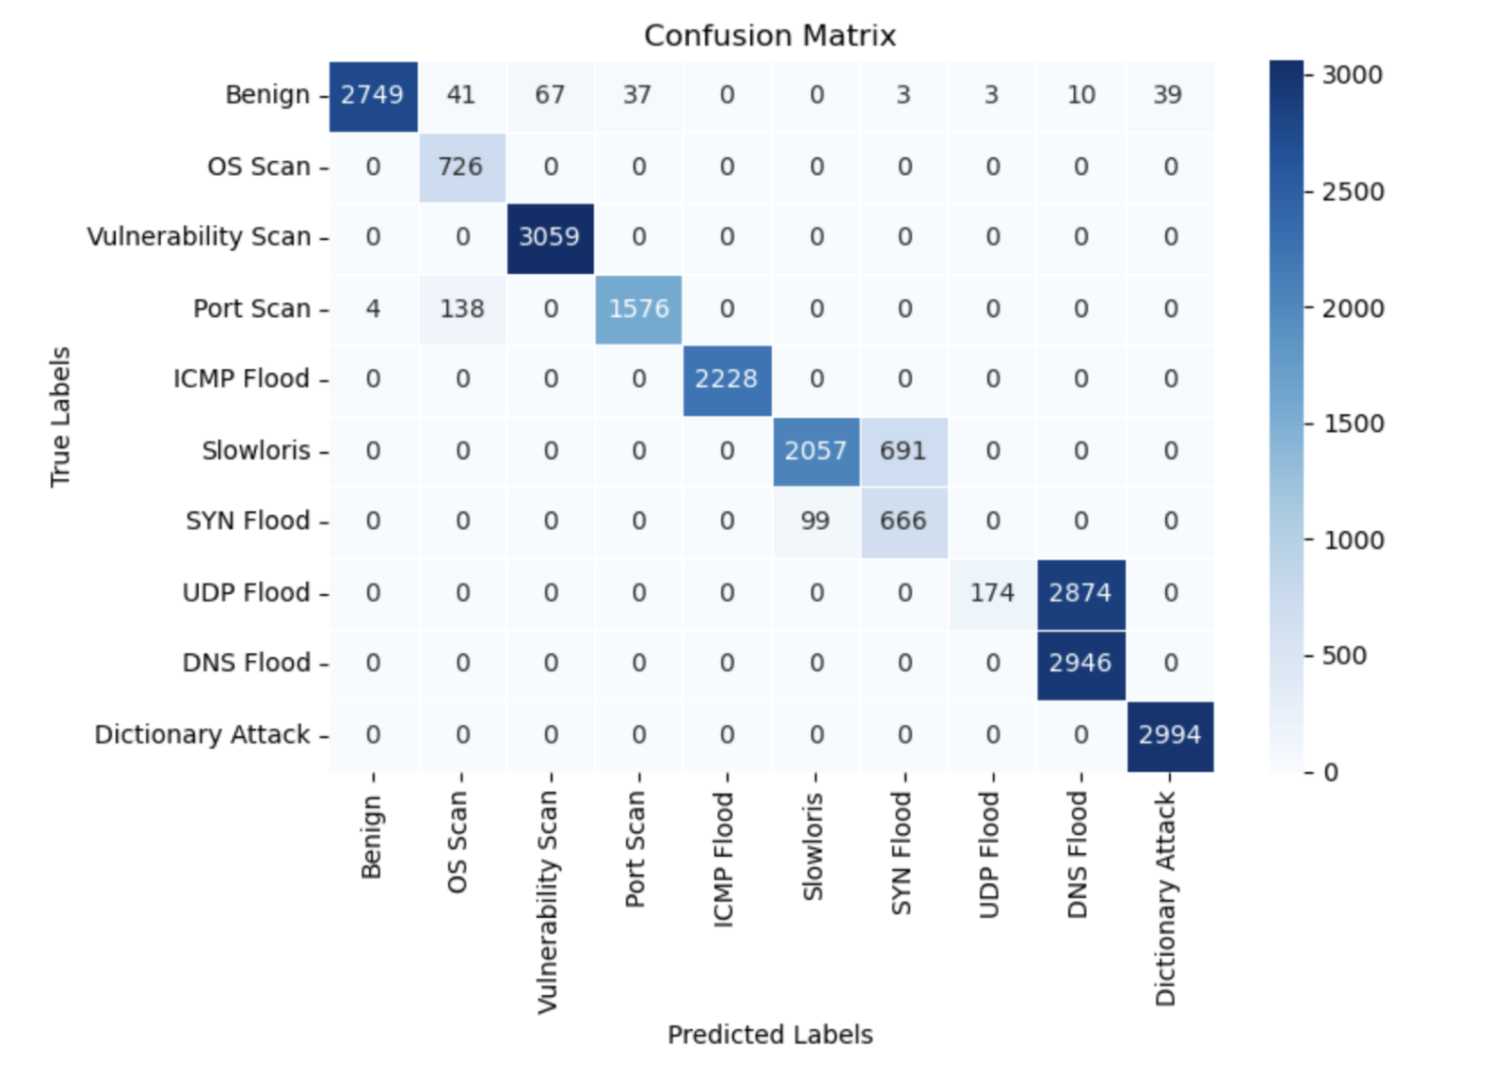
SVM - ACI-Iot Payload Dataset
In this study, similar to the preprocessing applied to the ACI-IoT dataset, StandardScaler was employed to standardize the features, facilitating effective classification of the imbalanced dataset.
The SVM model was configured with RBF kernel and the class weight equal to balanced parameter to address the class imbalance to address and adjust the weight.
Confusion matrix plotted and performance measures were computed for the payload dataset.
Fig: Confusion matrix heatmap for SVM on ACI-IoT-Payload dataset. Performance metrics include Accuracy = 0.8272, Precision = 0.9001, Recall = 0.8272, and F1 Score = 0.7953, and Training time = 5.54 seconds.

Slide 22
DECISION TREE
A decision tree is a non-parametric supervised learning algorithm, which is used for both classification and regression tasks.
It has a hierarchical tree structure, which consists of a root node, branches, internal nodes, and leaf nodes.
In splitting criterion, entropy was taken as it measures information gain using log function other than Gini impurity that uses simple calculation.

Slide 23

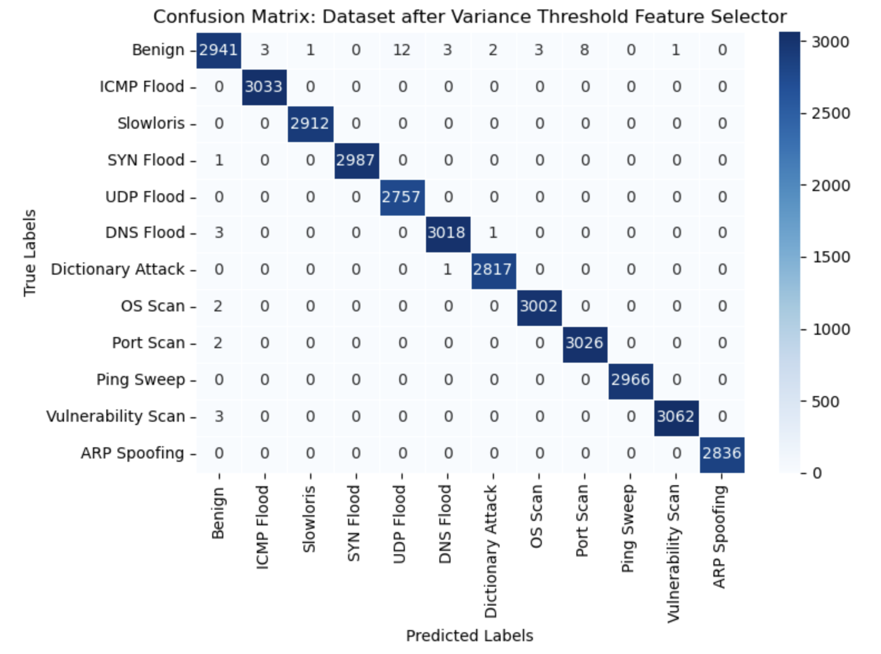
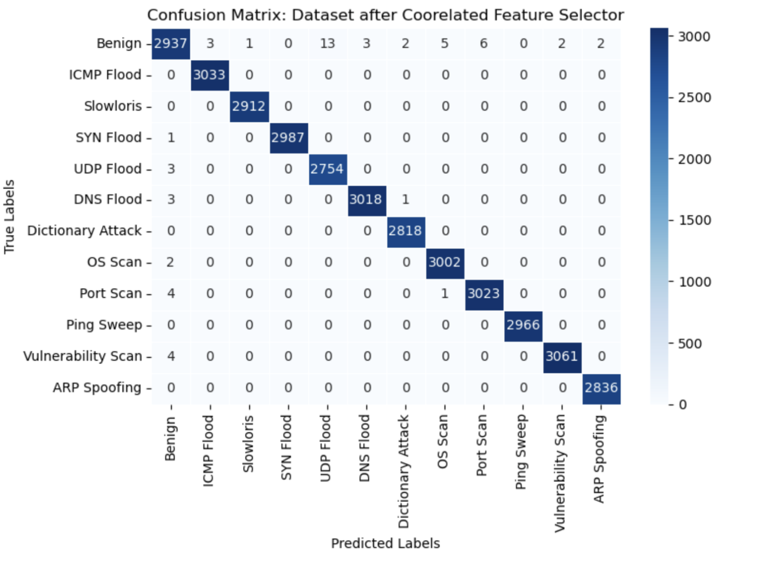
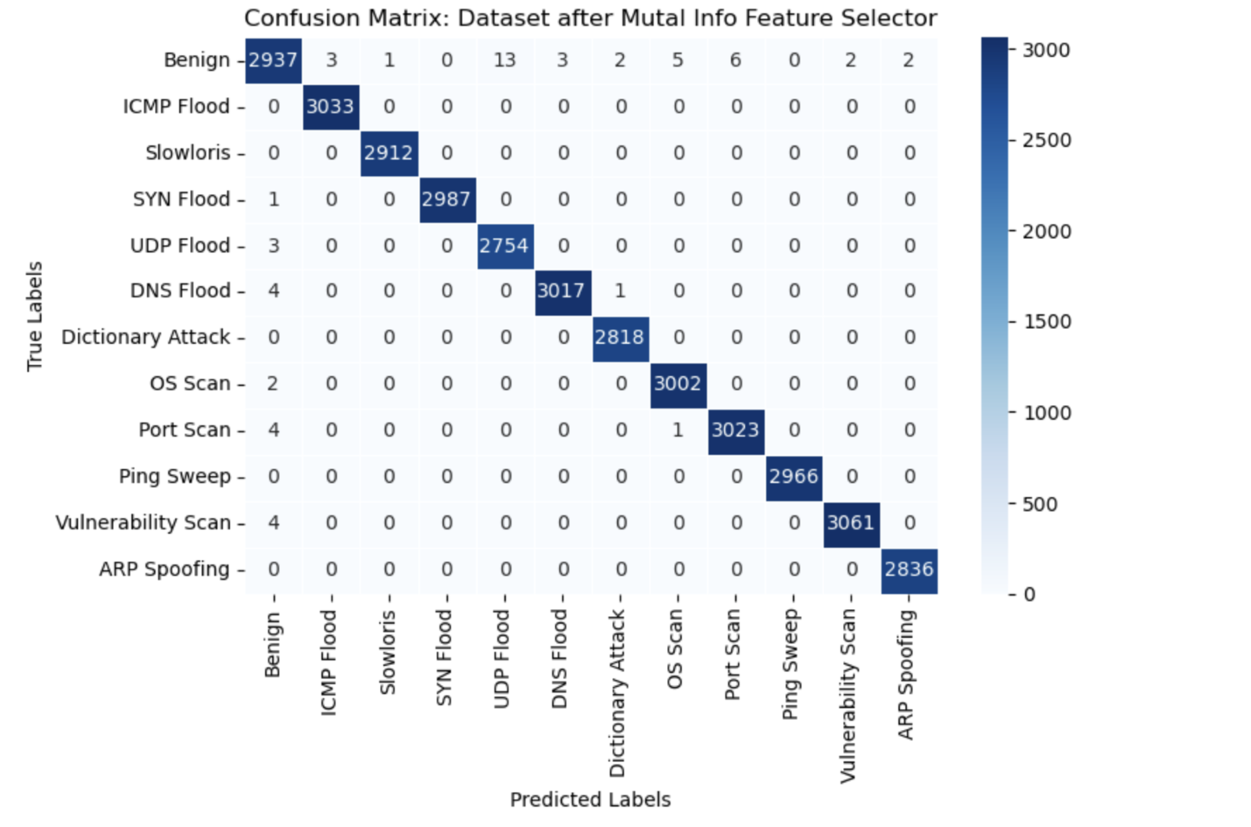
Decision tree - ACI-Iot Dataset
Fig 1: Confusion matrix heatmap for Decision Tree on ACI-IoT dataset. Performance metrics include Accuracy = 0.9984, Precision = 0.9984, Recall = 0.9984, and F1 Score = 0.9984, and Training time = 0.560 seconds.
Fig 2: Confusion matrix heatmap for Decision Tree on ACI-IoT dataset (data after variance threshold feature selector method) Performance metrics include Accuracy = 0.9987, Precision = 0.9987, Recall = 0.9987, F1 Score = 0.9987, and Training time = 1.0600 seconds.
Fig 3: Confusion matrix heatmap for Decision Tree on ACI-IoT dataset (data after correlated feature selector method) Performance metrics include Accuracy = 0.9984, Precision = 0.9984, Recall = 0.9984, F1 Score = 0.9984, and Training time = 0.550 seconds.
Fig 4: Confusion matrix heatmap for Decision Tree on ACI-IoT dataset (data after mutual info feature selector method) Performance metrics include Accuracy = 0.9984, Precision = 0.9984, Recall = 0.9984, and F1 Score = 0.9984, and Training time = 0.5400 seconds.

Slide 24
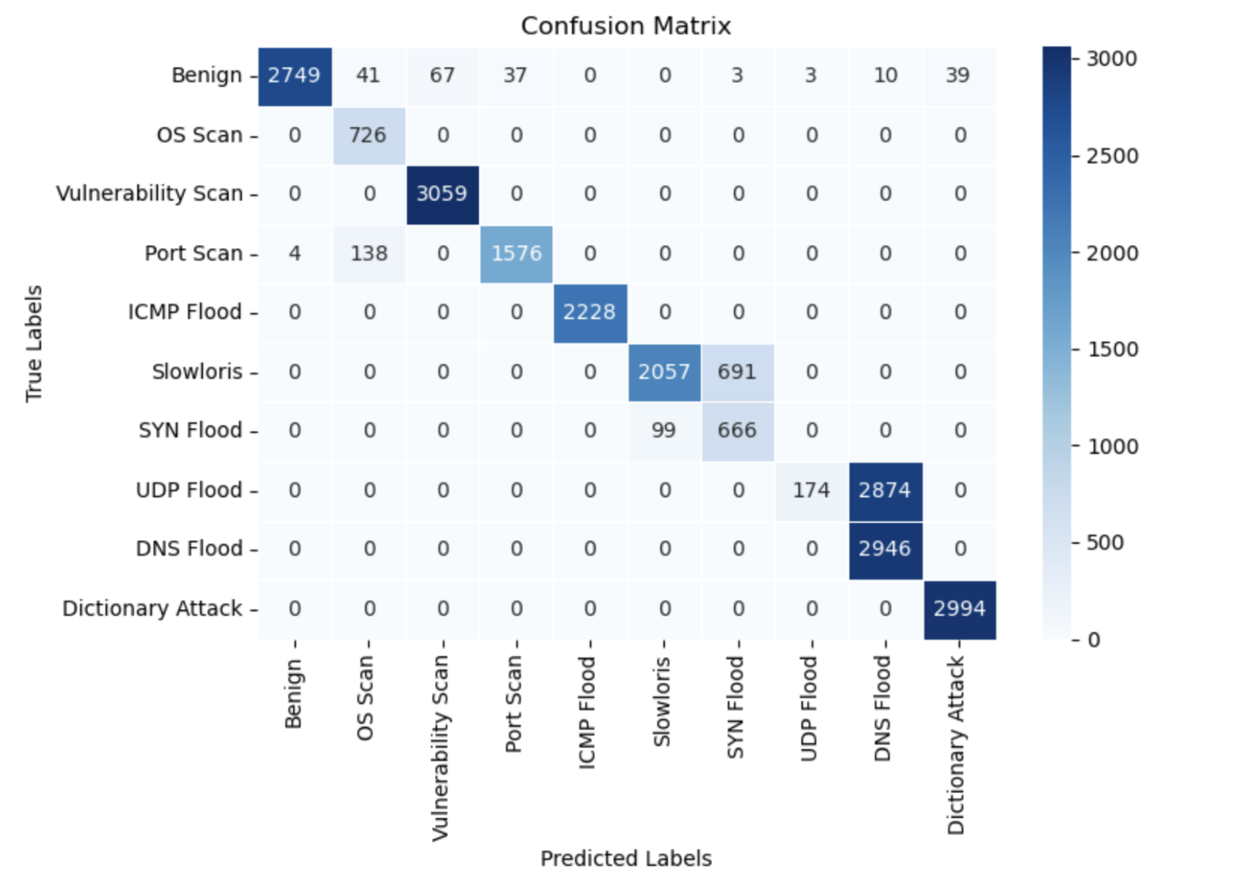
Decision tree - ACI-Iot Payload Dataset
In this study, similar to the process for ACI-IoT dataset, a DecisionTreeClassifier with other parameters for balanced performance was utilized for the dataset.
The class_weight parameter was taken as 'balanced' to ensure the model compensates for any class imbalance in the dataset
Confusion matrix plotted and performance measures were computed for the payload dataset.
Fig: Confusion matrix heatmap for Decision Tree on ACI-IoT-Payload dataset. Performance metrics include Accuracy = 0.9987, Precision = 0.9987, Recall = 0.9987, and F1 Score = 0.9987, and Training time = 0.12 seconds.

Slide 25
Random forest model
A Random Forest is a collection of decision trees that work together to make predictions. It takes different random parts of the dataset to train each tree following which it combines the results by averaging them.
This approach helps improve the accuracy of predictions and reduce errors.

Slide 26
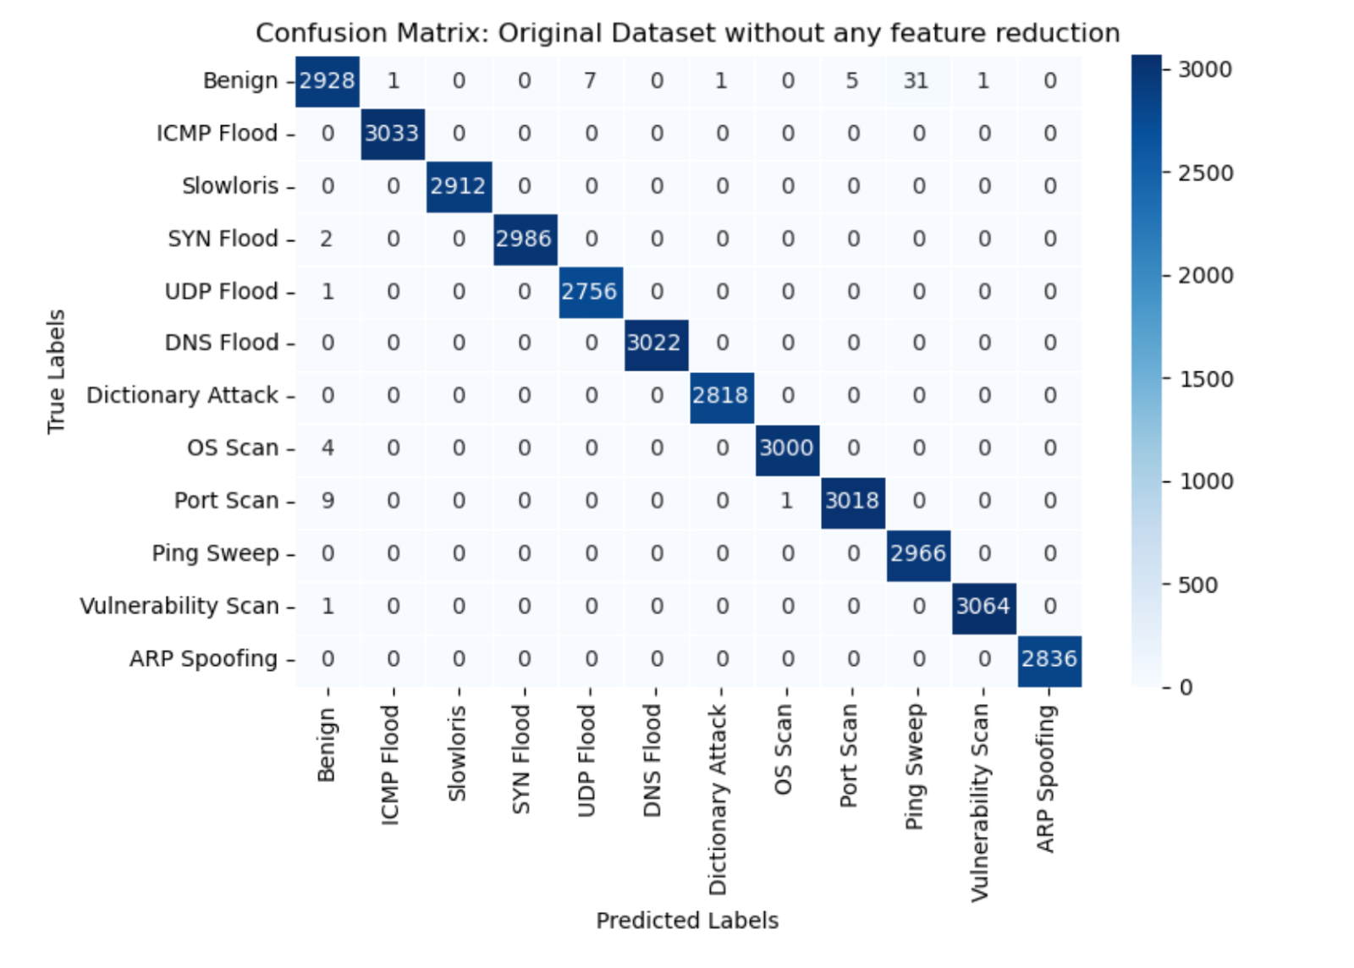
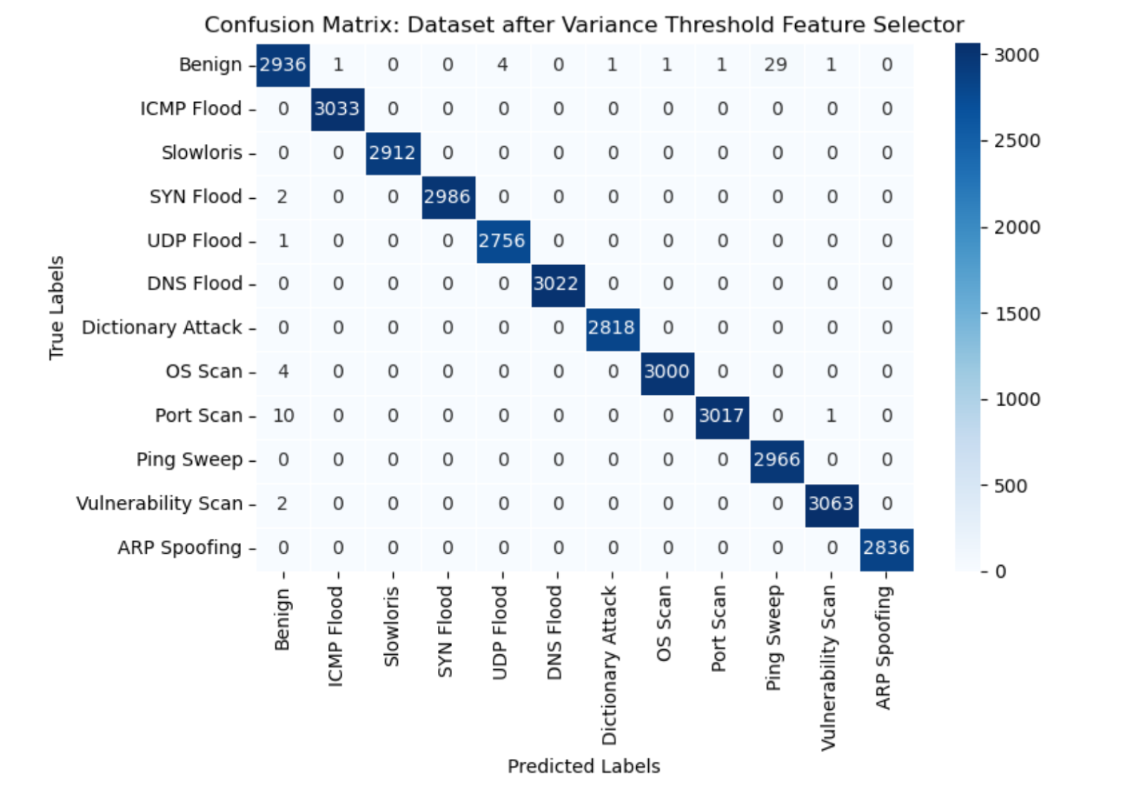
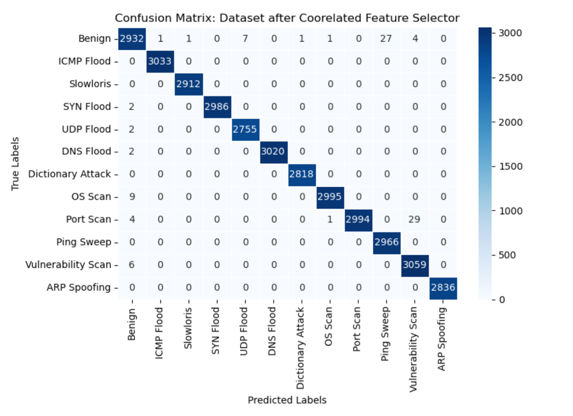
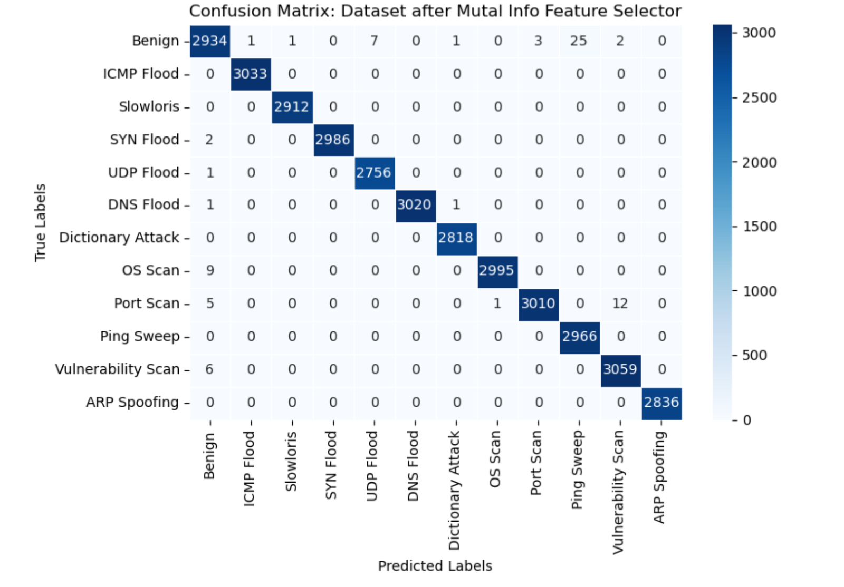
RANDOM FOREST - ACI-Iot Dataset
Fig 1: Confusion matrix heatmap for Random Forest Model on ACI-IoT dataset. Performance metrics include Accuracy = 0.9979, Precision = 0.9979, Recall = 0.9979, and F1 Score = 0.9979, and Training time = 8.000 seconds.
Fig 2: Confusion matrix heatmap for Random Forest Model on ACI-IoT dataset (data after variance threshold feature selector method) Performance metrics include Accuracy = 0.9808, Precision = 0.9982, Recall = 0.9982, and F1 Score = 0.9982, and Training time = 9.730 seconds.
Fig 3: Confusion matrix heatmap for Random Forest Model on ACI-IoT dataset (data after correlated feature selector method) Performance metrics include Accuracy = 0.9982, Precision = 0.9982, Recall = 0.9983, F1 Score = 0.9982, and Training time = 7.5900 seconds.
Fig 4: Confusion matrix heatmap for Random Forest Model on ACI-IoT dataset (data after mutual info feature selector method) Performance metrics include Accuracy = 0.9983, Precision = 0.9983, Recall = 0.9983, and F1 Score = 0.9983, and Training time = 8.0800 seconds.

Slide 27
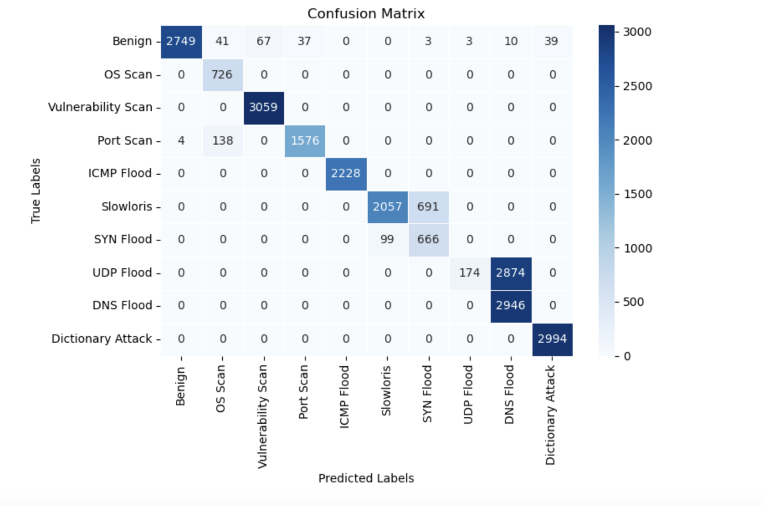
RANDOM FOREST - ACI-Iot Payload Dataset
In the study, similar to the approach used with ACI-IoT dataset, the Random Forest classification model was trained using balanced class weights, 100 estimators, and entropy as the splitting criterion, with a maximum tree depth of 10 to mitigate overfitting.
The model was trained from train data, and predictions were generated on the test dataset.
Confusion matrix plotted and performance measures were computed for the payload dataset.
Fig: Confusion matrix heatmap for Random Forest Model on ACI-IoT-Payload dataset. Performance metrics include Accuracy = 0.9992, Precision = 0.9992, Recall = 0.9992, and F1 Score = 0.9992, and Training time = 2.20 seconds.

Slide 28
MODEL EVALUATION
Model evaluation is a process that involves the use of quantitative metrics to analyze the performance of the model.
Model evaluation serves as a means of testing whether the model has learned the pattern and data or has merely memorized the predictions.
Evaluation metrics, identify potential weaknesses in a model, it may arise due to excessive model complexity relative to the dataset, data leakage, or other issues that hinder the model's ability to perform effectively and generate accurate predictions.

Slide 29
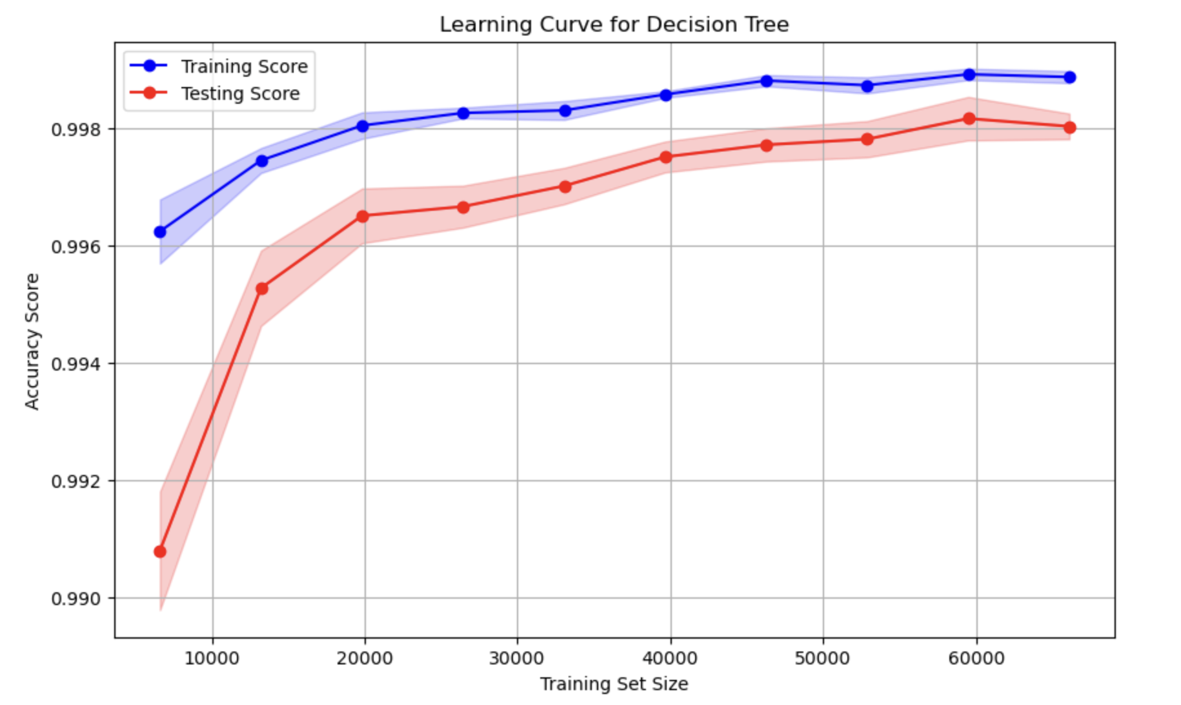
LEARNING CURVE FOR DECISION tree – ACI-IoT Dataset
Learning curve helps assess the underfitting and overfitting of the model.
The training score remains high, that is 0.998, suggesting that model fits the training data very well.
The testing score also increases steadily, reaching 0.998 with an increase in data sizes, which indicates a generalization tendency.
The gap between the training and testing curves as data size increases suggests that the model is not overfitting.

Slide 30
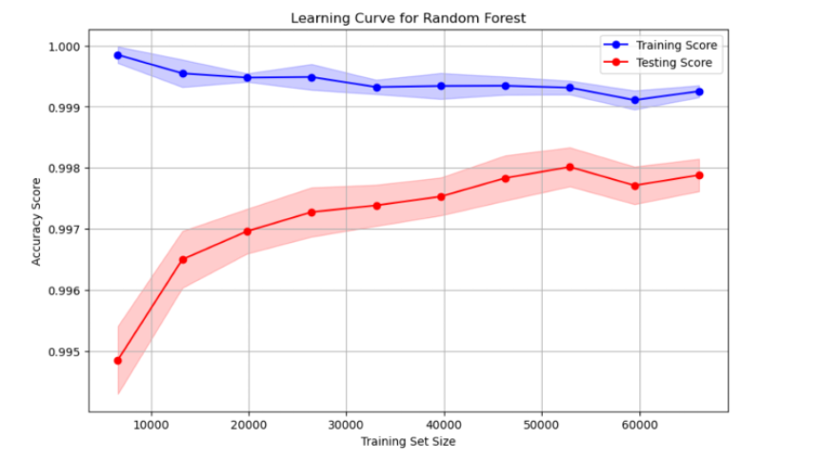
LEARNING CURVE FOR RANDOM FOREST – ACI-IoT Dataset
The learning curve for the Random Forest classifier, shows the models' performance across different training set sizes.
The testing accuracy, steadily improves with training set size, reaching 0.995 and then to 0.998.
The graph going upwards shows that the model fits and generalizes better with increased training samples.

Slide 31
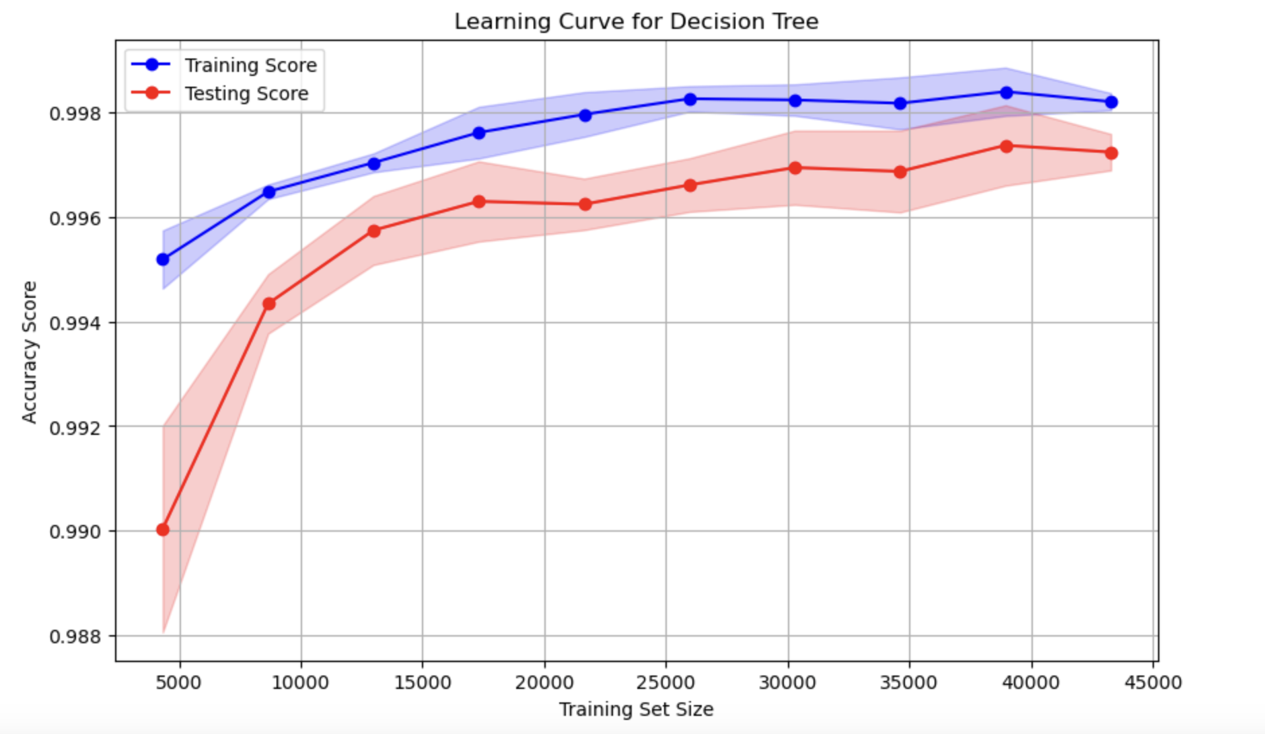
LEARNING CURVE FOR DECISION tree – ACI-IoT PAYLOAD Dataset
The training accuracy remains consistently high, nearing 0.998, while the testing accuracy slightly lags but also stabilizes around 0.997.
The narrowing gap between training and testing curves, along with reduced variance at larger training sizes, suggests that the model generalizes well and is not overfitting.

Slide 32
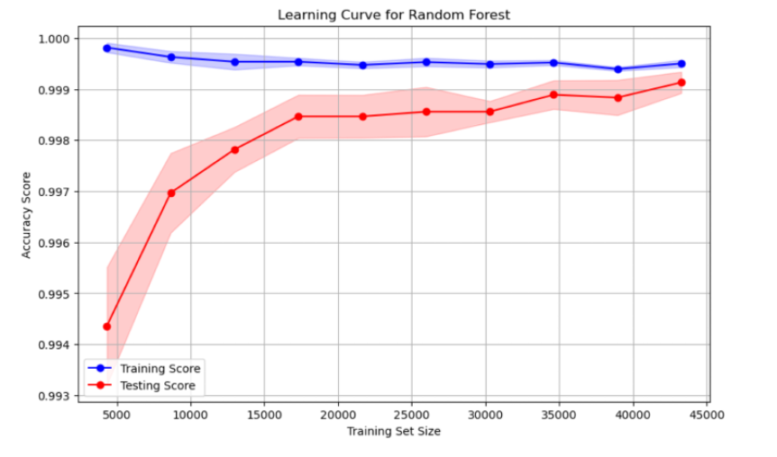
LEARNING CURVE FOR RANDOM FOREST – ACI-IoT PAYLOAD Dataset
The narrowing gap between the training and testing scores as the training size increases suggests improved generalization performance.
The shaded regions around each curve represent the standard deviation, highlighting the variability in performance across cross-validation folds.

Slide 33
CONCLUSION
For ACI-IoT Dataset:
 | Accuracy | Precision | Recall | F-1 Score | Training Time(sec)
SVM | 0.9808 | 0.9815 | 0.9810 | 0.9808 | 21.100
Decision Tree | 0.9984 | 0.9984 | 0.9984 | 0.9983 | 0.560
Random Forest | 0.9979 | 0.9978 | 0.9979 | 0.9978 | 8.000
For ACI-IoT Payload Dataset:
 | Accuracy | Precision | Recall | F-1 Score | Training Time(sec)
SVM | 0.8272 | 0.9001 | 0.8272 | 0.7953 | 5.54
Decision Tree | 0.9987 | 0.9987 | 0.9987 | 0.9986 | 0.12
Random Forest | 0.9992 | 0.9992 | 0.9992 | 0.9991 | 2.20

Slide 34
CONCLUSION
The evaluation results indicates that Decision Tree and Random Forest classifiers outperforms SVM in both accuracy and training time across the ACI-IoT and its payload dataset.
With both Decision Tree and Random Forest maintaining high performance, decision tree offers the fastest training time, while the random forest provides better generalization with higher performance metrics.
Random Forest exhibited optimal performance in measures of accuracy, precision, recall and F-1 score, making the model suitable for deployment in a network intrusion system

Slide 35
Acknowledgement
Advisor - Gokhan Kul
Committee - Ashokkumar Patel
Committee - Lance Fiondella
Committee - Firas Khatib
University Professors and Friends
Friends & Family

Slide 36
Thank You! J
Q & A

